Slide 1
Predictors of Incident and Persistent Internalizing Mental Disorders Among Ugandan Children and Adolescents Living With HIV: A Machine Learning Approach
Prepared By
Isaac Okello Opio
(PROGRESS REPORT)

Slide 2





CONCEPT OF THE STUDY
CHAKA study
368 cases vs 368 controls
Dr Dickens Akena
Dr. Kalungi Allan
Dr. Jjingo Daudi
Prof. E. Kinyanda
VULNERABILITY
Genetic
-SLC6A4
-TPH2
-FKBP5
-NR3C1
Biological
-Telomere length
-CD4 count
-HIV viral load
-WHO HIV clinical stage
Psychosocial
-Stress
-Social support
-Sociodemographic
PREDICTION: MACHINE LEARNING
Emotional disorders outcomes at 12 months
Source: Own source

Slide 3

STUDY AIMS
Aim 1
Build a machine learning model for prediction of incident and persistent cases of emotional disorders
Aim 2
Evaluate performance of the model for each of genetic, biological and psychosocial factors respectively
Aim 3
Evaluate performance of the model which includes all the three factor domains of genetic, biological and psychosocial factors

Slide 4
METHOD
01
02
03
Data Cleaning & Feature engineering
Choose algorithm (DT, RF, LR, SVM)
Identify data
05
04
Model Deployment
Train, Validate & Test the model
Source: https://slidesgo.com/

Slide 5
Machine Learning Model Development
Prerequisite
Dataset, Python (v3.11.5) and packages (Pandas), ML framework (Scikit Learn) etc.
Step 1: Data Splitting
Step 2: Model Building (Objective 1)
Supervised ML techniques
Decision trees, random forests, logistic regression, and support vector machines from Scikit Learn
Step 3: Model Evaluation (Objective 2)
The metrics (accuracy, precision, recall, and F1 score).
Step 4: Model Integration (Objective 3)
A model using all the three predictors (genetic, biological, and psychosocial factors) will be constructed.
Step 5: Predictions
Prediction on unseen data and feature importance.

Slide 6
THE MACHINE LEARNING PIPELINE
1. Prepare Problem
a) Load libraries
b) Load dataset
2. Summarize Data
a) Descriptive statistics
b) Data visualizations
3. Prepare Data
a) Data Cleaning
b) Feature Selection
c) Data Transforms
4. Evaluate Algorithms
a) Split-out validation dataset
b) Spot Check Algorithms and compare metrics (F1 was used to choose best model)
5. Improve Accuracy
a) Algorithm Tuning (hyper parameter tuning)
6. Finalize Model
a) Predictions on validation dataset
b) Feature importance selection

Slide 7
INCIDENT IMD
Definition: Newly occurring internalizing mental disorder (mood & emotional disorders like anxiety, depression, ptsd) on individuals who never had at the baseline.

Slide 8
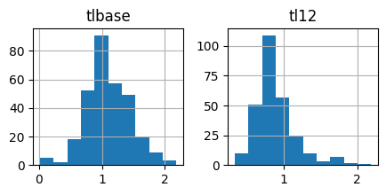
RESULTS/METHOD FOR INCIDENT IMD
Descriptive statistics
Data Size
Variables = 29
Sample size = 368
Number of duplicates
= 0
Distribution of the data
The numerical data were moderately skewed.
Figure 1: Plot for numerical data

Slide 9
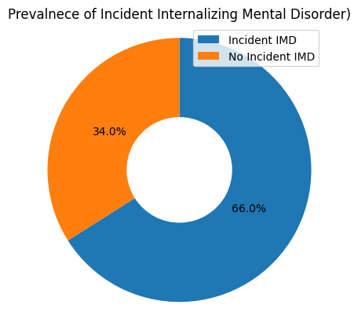
RESULTS/METHOD FOR INCIDENT IMD
Target
The prevalence of Incident IMD was 66.0% (243/368)
Handling missing values
Categorical variables: Mode
Numerical variables: Mean

Slide 10
RESULTS/METHOD FOR INCIDENT IMD
Profile Report before imputations
Missing cells = 698
Missing cells (%) = 6.5%
Variable types
Categorical = 27
Numeric = 2
Alerts (22)
Imbalanced data
Missing values
Profile Report after imputations
Missing cells = 0
Missing cells (%) = 0%
Variable types
Categorical = 26
Numeric = 3
Alerts (12)
Imbalanced data
High correlation

Slide 11
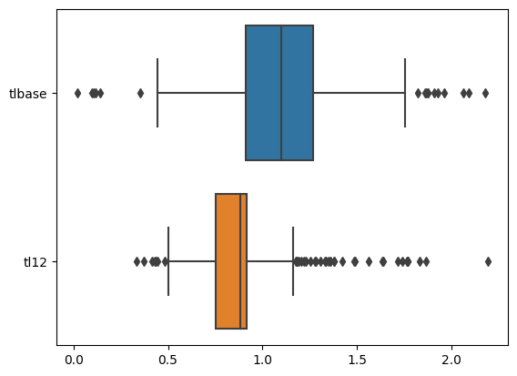
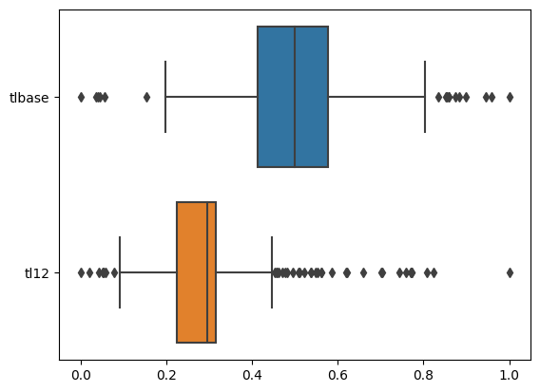
TRANSFORMATIONS FOR INCIDENT IMD
Label encoding (LabelEncoder) categorical variables
Scaling (MinMaxScaler) of numerical data to limit outliers
Before scaling
After scaling

Slide 12
MODEL SPOT-CHECKING FOR INCIDENT IMD
Using F1 Score, the best model at spot check was Linear Discriminant
Model | F1 Score | Precision | Recall | Accuracy | ROC AUC
Linear Discriminant Analysis | 0.67 | 0.67 | 0.69 | 0.69 | 0.65
Random Forest Classifier | 0.66 | 0.67 | 0.70 | 0.69 | 0.69
Logistic Regression | 0.64 | 0.64 | 0.67 | 0.67 | 0.65
Gradient Boosting Classifier | 0.63 | 0.65 | 0.65 | 0.65 | 0.64
Ada Boost Classifier | 0.62 | 0.62 | 0.63 | 0.63 | 0.59
KNeighbors Classifier | 0.60 | 0.59 | 0.63 | 0.63 | 0.58
Decision Tree Classifier | 0.58 | 0.62 | 0.61 | 0.60 | 0.53
Gaussian NB | 0.58 | 0.62 | 0.57 | 0.57 | 0.58
SVC | 0.56 | 0.58 | 0.67 | 0.67 | 0.66
Table: Performance of the model in the analysis during spot checking.

Slide 13
IMPROVING ACCURACY FOR INCIDENT IMD
Hyperparameter tuning
Used to optimize the performance of machine learning models by searching for the best set of hyperparameters.
Hyperparameters are settings that are not learned from the data but are set prior to training.
E.g: Regularization strength in logistic regression, the depth of a decision tree, or the number of trees in a random forest.

Slide 14
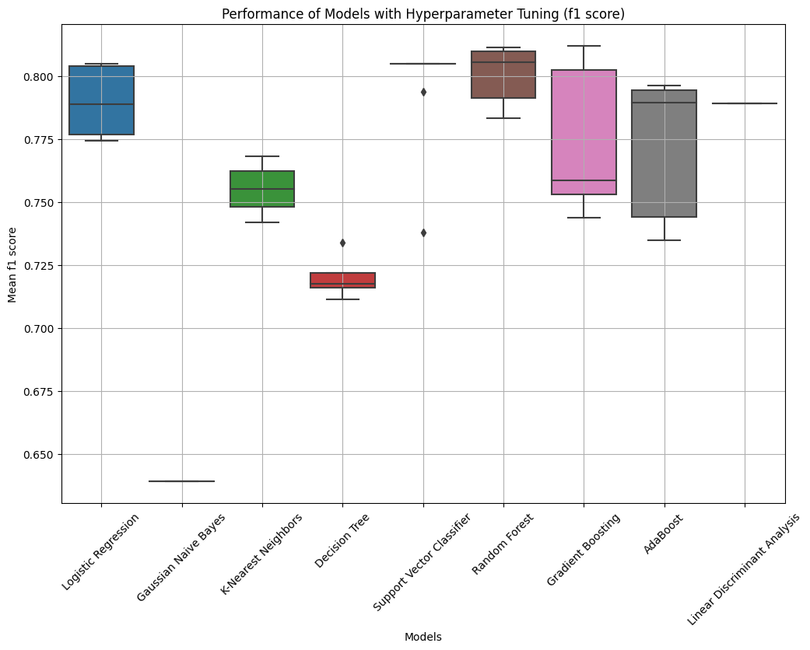
IMPROVING ACCURACY FOR INCIDENT IMD
Best Model: Random Forest (81.6%)
Model | F1 Score | Accuracy
Random Forest | 0.816 | 0.721
Gradient Boosting | 0.812 | 0.718
Logistic Regression | 0.805 | 0.690
Support Vector Classifier | 0.805 | 0.674
AdaBoost | 0.796 | 0.697
Linear Discriminant Analysis | 0.789 | 0.690
K-Nearest Neighbors | 0.768 | 0.653
Decision Tree | 0.748 | 0.629
Gaussian Naive Bayes | 0.639 | 0.568
Table: Model performance after hyper parameter tuning

Slide 15
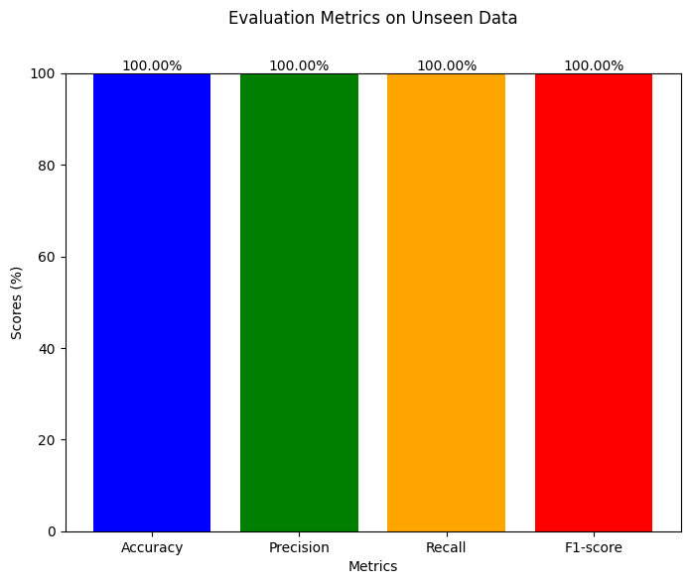
PERFORMANCE OF BEST MODEL
Random Forest (Best Model) performance on unseen data was:
Accuracy: 100%
Precision: 100%
Recall: 100%
F1-score: 100%
This indicates a perfect performance.
Concern: Has it over fitted?
Solution: Need for prediction on totally independent data.

Slide 16
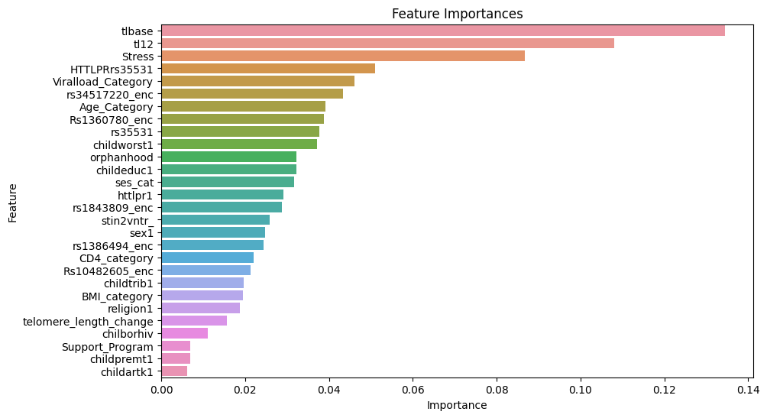
FEATURE IMPORTANCE FOR INCIDENT IMD
Feature importance: features with the most impact on a model's predictions.
For Incident IMD, the most important features were;
1. Telomere length at baseline
2. Telomere length at end line (Month 12)
3. Stress
4. HTTLPRrs35531 polymorphism
5. Viralload

Slide 17
CONCLUSION FOR INCIDENT IMD
The best ML model for predicting incident IMD is Random Forest (81.6% F1 Score i.e. better precision [accuracy] and recall [sensitivity]).
Testing Random Forest with original data yielded 100% perfect predictions for all instances of incident IMD.
Recommendations:
There is need for a larger dataset to perform future model development, and limit over fitting.
There is need for independent dataset to test the model on so as to rule out the possibility of over fitting or data leakage, thereby improving the reliability of the model.

Slide 18
PERSISTENT IMD
Definition: Enduring/ongoing internalizing mental disorder (mood & emotional disorders like anxiety, depression, ptsd) among individuals who had IMD at the baseline.

Slide 19
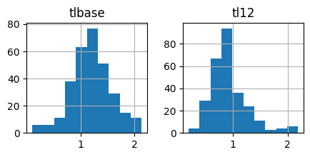
RESULTS/METHOD FOR PERSISTENT IMD
Descriptive statistics
Data Size
Variables = 29
Sample size = 368
Number of duplicates
= 0
Distribution of the data
The was moderately skewed.
Figure 1: Plot for numerical data

Slide 20
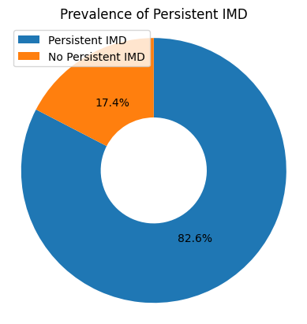
RESULTS/METHOD FOR PERSISTENT IMD
Target
The prevalence of Persistent IMD was 82.6% (304/368)
Handling missing values
Categorical variables: Mode
Numerical variables: Mean

Slide 21
RESULTS/METHOD FOR PERSISTENT IMD
Profile Report before imputations
Missing cells = 579
Missing cells (%) = 5.4%
Variable types
Categorical = 27
Numeric = 2
Alerts (21)
Imbalanced data
Missing values
Profile Report after imputations
Missing cells = 0
Missing cells (%) = 0%
Variable types
Categorical = 26
Numeric = 3
Alerts (11)
Imbalanced data
High correlation
Zeros

Slide 22
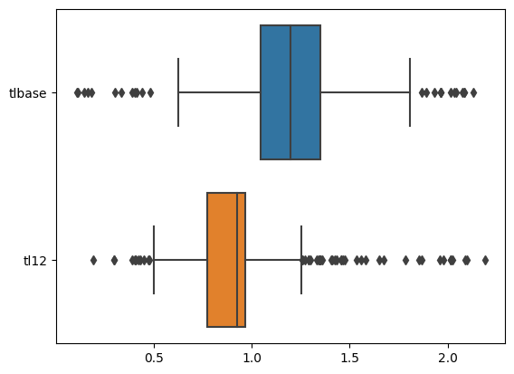
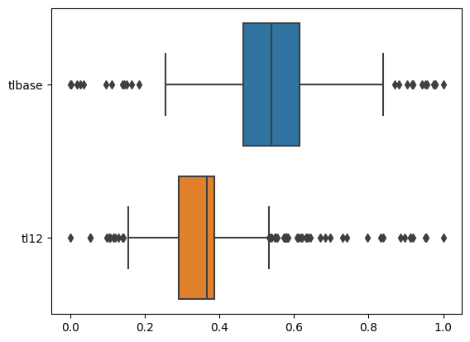
TRANSFORMATIONS FOR PERSISTENT IMD
Label encoding (LabelEncoder) categorical variables
Scaling (MinMaxScaler) of numerical data to limit outliers
Before scaling
After scaling

Slide 23
MODEL SPOT-CHECKING FOR PERSISTENT IMD
Using F1 Score, the best model at spot check was KNeighbors Classifier
Model | F1 Weighted | Precision | Recall | Accuracy | ROC AUC
Logistic Regression | 0.769 | 0.722 | 0.823 | 0.823 | 0.638
Gaussian NB | 0.649 | 0.722 | 0.652 | 0.652 | 0.541
KNeighbors Classifier | 0.804 | 0.786 | 0.844 | 0.844 | 0.659
Decision Tree Classifier | 0.763 | 0.764 | 0.776 | 0.762 | 0.522
SVC | 0.777 | 0.718 | 0.847 | 0.847 | 0.631
Random Forest Classifier | 0.775 | 0.717 | 0.844 | 0.851 | 0.677
Gradient Boosting Classifier | 0.787 | 0.751 | 0.830 | 0.833 | 0.677
Ada Boost Classifier | 0.765 | 0.739 | 0.800 | 0.800 | 0.608
Linear Discriminant Analysis | 0.759 | 0.724 | 0.799 | 0.799 | 0.646
Table: Performance of the model in the analysis during spot checking.

Slide 24
IMPROVING ACCURACY FOR PERSISTENT IMD
Hyperparameter tuning
Used to optimize the performance of machine learning models by searching for the best set of hyperparameters.
Hyperparameters are settings that are not learned from the data but are set prior to training.
E.g: Regularization strength in logistic regression, the depth of a decision tree, or the number of trees in a random forest.

Slide 25
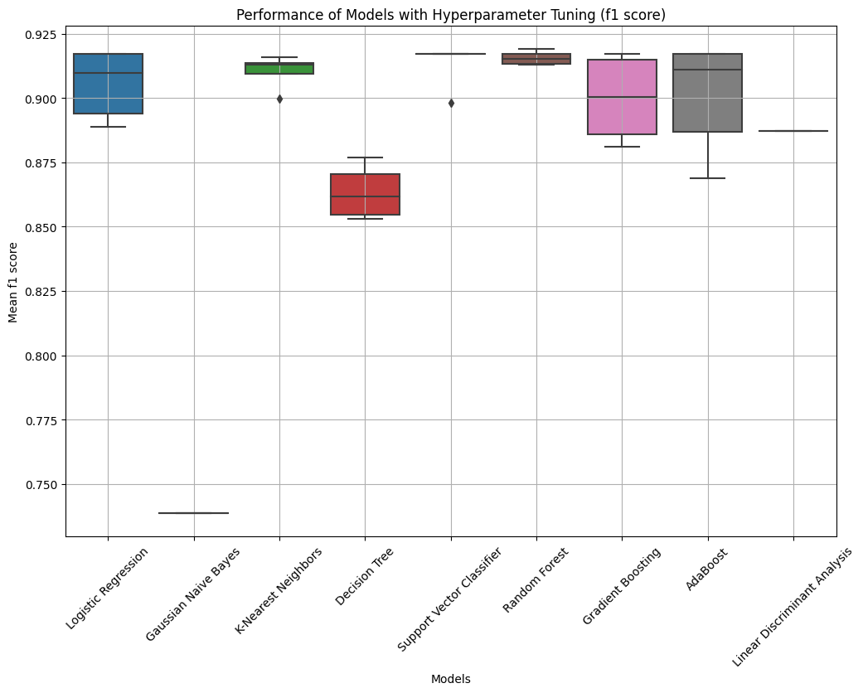
IMPROVING ACCURACY FOR PERSISTENT IMD
Best Model: Random Forest (91.9%)
Model | F1 Score | Accuracy
Random Forest | 0.919 | 0.847
Logistic Regression | 0.917 | 0.847
Support Vector Classifier | 0.917 | 0.847
Gradient Boosting | 0.917 | 0.847
AdaBoost | 0.917 | 0.847
K-Nearest Neighbors | 0.916 | 0.847
Linear Discriminant Analysis | 0.887 | 0.799
Decision Tree | 0.880 | 0.799
Gaussian Naive Bayes | 0.739 | 0.652
Table: Model performance after hyper parameter tuning

Slide 26
PERFORMANCE OF BEST MODEL
Random Forest (Best Model) performance on unseen data was:
Accuracy: 100%
Precision: 100%
Recall: 100%
F1-score: 100%
This indicates a perfect performance.
Concern: Has it over fitted?
Solution: Need for prediction on totally independent data.

Slide 27
FEATURE IMPORTANCE FOR PERSISTENT IMD
Feature importance: features with the most impact on a model's predictions.
For Incident IMD, the most important features were;
1. Telomere length at baseline
2. Telomere length at end line (Month 12)
3. Stress
4. Age
5. Worst HIV Clinical Stage Ever attained

Slide 28
CONCLUSION FOR PERSISTENT IMD
The best ML model for predicting incident IMD is Random Forest (91.9% F1 Score i.e. better precision [accuracy] and recall [sensitivity]).
Testing Random Forest with original data yielded 100% perfect predictions for all instances of persistent IMD.
Recommendations:
There is need for a larger dataset to perform future model development, and limit over fitting.
There is need for independent dataset to test the model on so as to rule out the possibility of over fitting or data leakage, thereby improving the reliability of the model.

Slide 29
OVERALL STUDY CONCLUSION
The project is scalable to include other psychiatric conditions.
Machine learning models performed better in predicting persistent (91.9%) IMD than incident IMD (81.6%).
High prevalence of missing values might have compromise the model reliability.
Imputation methods used (mode for categorical, mean for numerical) might have introduced biases.
Low sample size (n=368 for each case) raises concerns of overfitting, limiting model generalizability.

Slide 30
THE END

